Slide 1
SIGN LANGUAGE RECOGNITION USING MACHINE LEARNING
l

Slide 2
Abstract
Communication is very significant to human beings as it facilitates the spread of knowledge and forms relationships between people. We communicate through speech, facial expressions, hand signs, reading, writing or drawing etc. But speech is the most commonly used mode of communication. However, people with hearing and speaking disability only communicate through signs, which makes them highly dependent on non-verbal forms of communication. India is a vast country, having nearly five million people deaf and hearing impaired. Still very limited work has been done in this research area, because of its complex nature. Indian Sign Language (ISL) is predominantly used in South Asian countries and sometimes, it is also called as Indo-Pakistani Sign Language (IPSL).

Slide 3
Literature Survey
Sno | Name of Author | Literature review | Limitation
1 | Pavan Kumar | Sign Language Recognition | Due to the diversity and complexity of sign languages across different regions and cultures, it is challenging to collect a large and representative dataset that covers a wide range of sign language gestures
2 | Ms. Greeshma Pala | Machine Learning-based Hand Sign Recognition | Sign languages differ across regions and cultures, with unique grammar, vocabulary, and dialects. Developing a sign language recognition system that can accurately interpret all these variations is a challenging task

Slide 4
Existing system
Deaf (hard hearing) and dumb people use Sign Language (SL) [1] as their primary means to express their ideas and thoughts with their own community and with other people with hand and body gestures. It has its own vocabulary, meaning, and syntax which is different from the spoken language or written language. Spoken language is a language produced by articulate sounds mapped against specific words and grammatical combinations to convey meaningful messages. Sign language uses visual hand and body gestures to convey meaningful messages. There are somewhere between 138 and the hand gestures are recognized in the live camera and then converting them to text. This system will help deaf and dumb people to communicate easily.

Slide 5
Proposed system
The purpose of this project is to recognize all the alphabets (A-Z) and digits (0-9) of Indian sign language using bag of visual words model and convert them to text/speech. Dual mode of recognition is implemented for better results. The system is tested using various machine learning classifiers like KNN, SVM, logistic regression and a convolutional neural network (CNN) is also implemented for the same. The dataset for this system is created manually in different hand orientations and a train-test ratio of 80:20 is used.

Slide 6
Algorithm
Convolutional neural networks
Support vector machine
Naive bayes
K-nearest neighbour
Logistic regression

Slide 7
Methodology
1.Data Collection: Gathering a large dataset of sign language videos or images, capturing various gestures and expressions. 2. Preprocessing: Cleaning and preparing the collected data, which may involve resizing, cropping, and normalizing the images or videos. 3. Feature Extraction: Extracting relevant features from the preprocessed data, such as hand shape, movement, and facial expressions. 4. Training: Using machine learning algorithms, such as deep learning models like Convolutional Neural Networks (CNNs) to train the system on the extracted features. 5. Recognition: Once the model is trained, it can be used to recognize and interpret sign language gestures in real-time. This involves capturing live video input, preprocessing it, and feeding it into the trained model for prediction.

Slide 8
Module Explanation
Module 1
Login page
1.User name-
This allows users to easily remember and enter their login information.
2.Password
A password for a login page is a secret combination of characters that a user creates to authenticate their identity and gain access to a system or account.

Slide 9
Module 2
predict sign :
The predict module outputs the predicted sign, which can be in the form of a text label and give audio
Module 3
Translate speech :
First, the speech signal is captured using a microphone or other audio input device. Then, the speech signal is processed and converted into text and show hand gesture image

Slide 10
Module 4
Create sign :
We can design as many different signs as we need in this modules
Module 5
Developer:
In this module all information about who is develop this project like author name

Slide 11
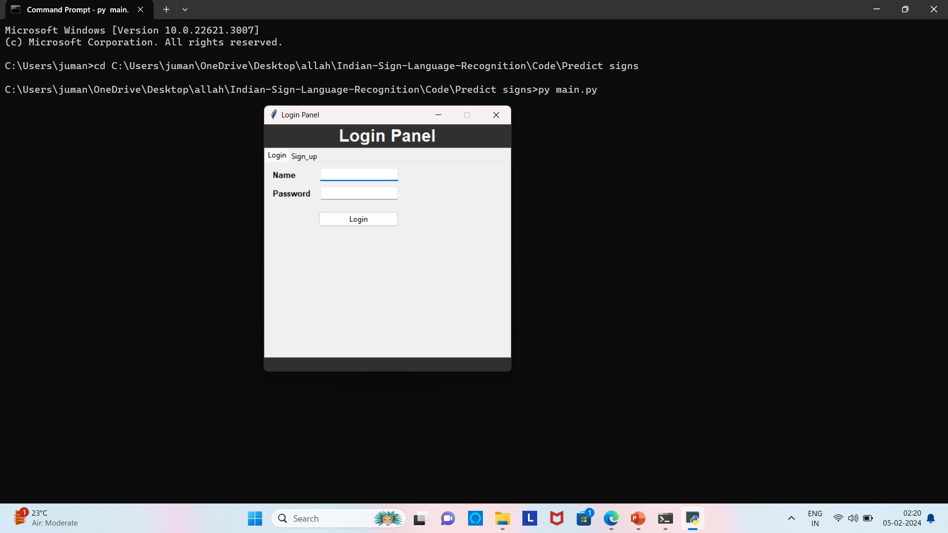
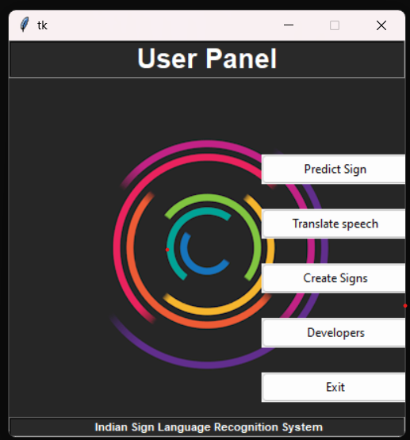
Modules screenshot

Slide 12
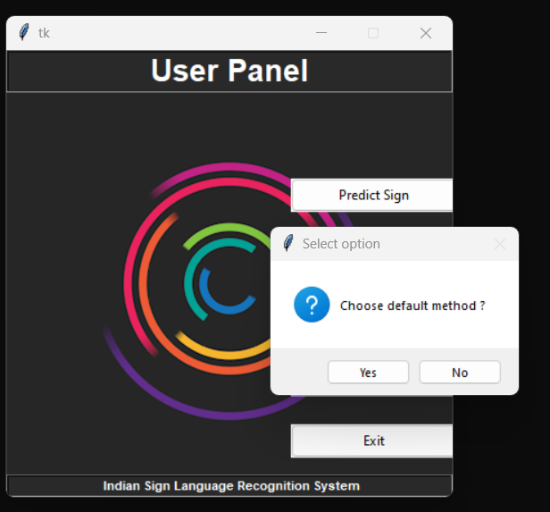

Slide 13
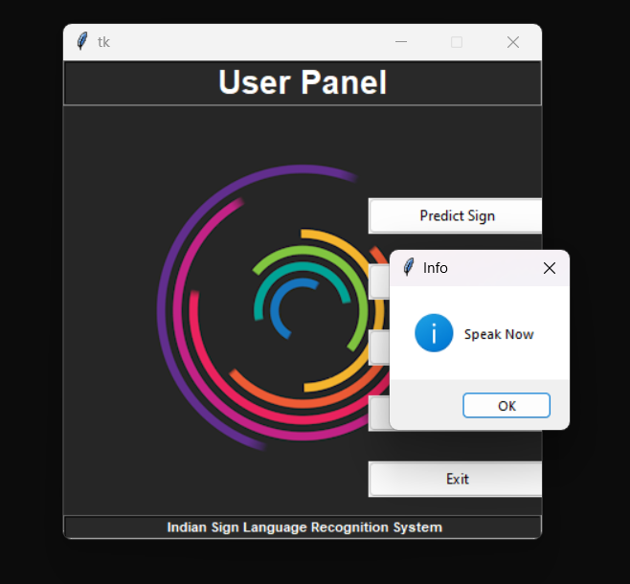
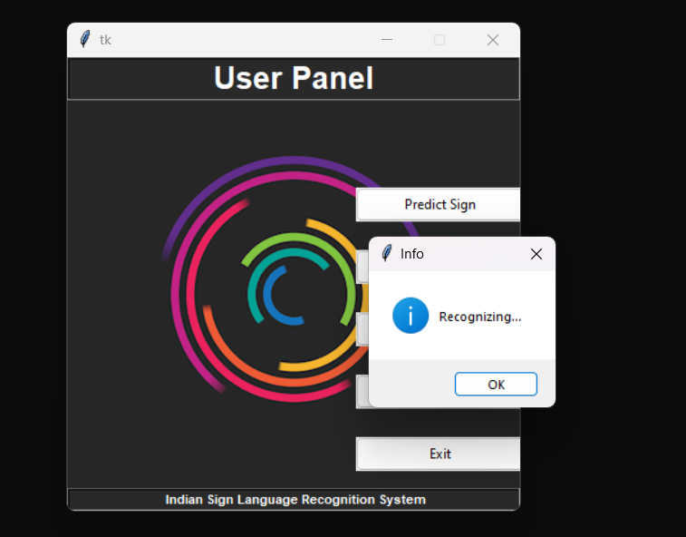

Slide 14
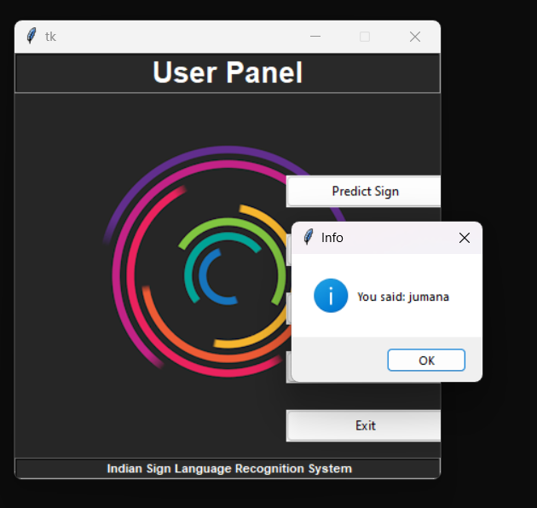
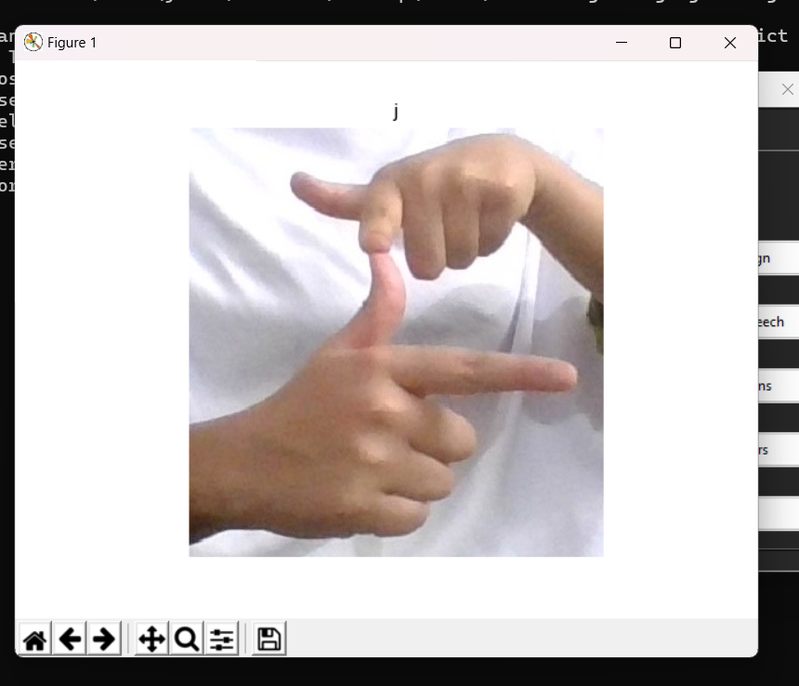

Slide 15
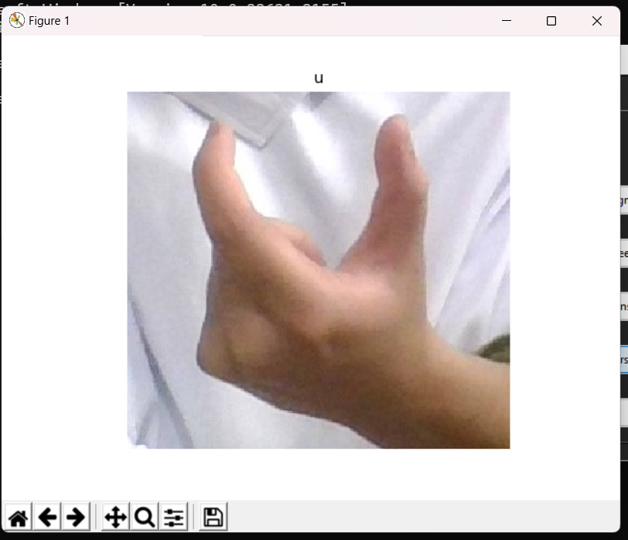
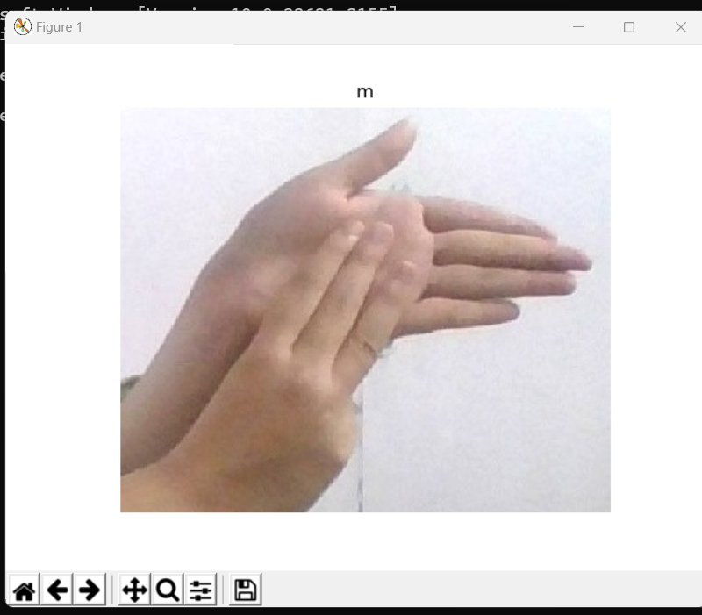

Slide 16
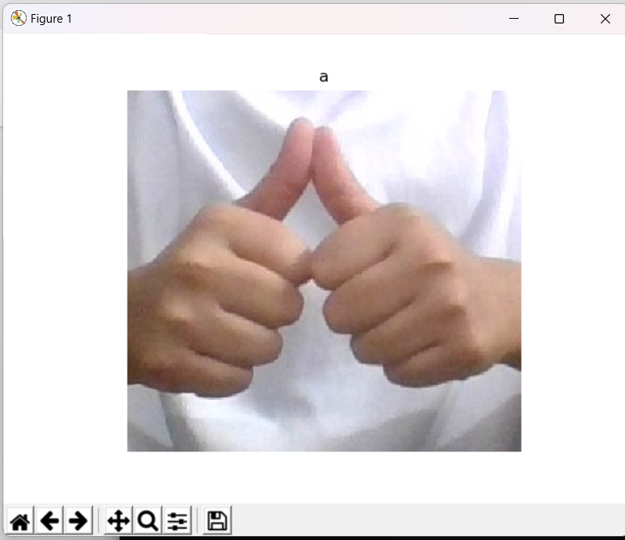
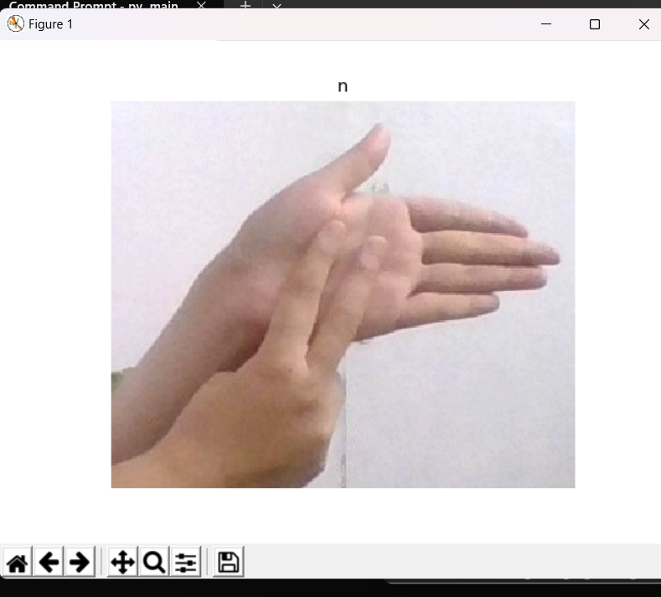

Slide 18
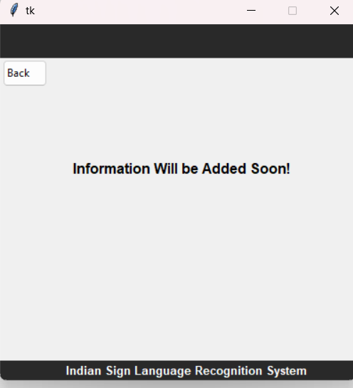

Slide 19
Conclusion
In conclusion, we were successfully able to develop a practical and meaningful system that can able to understand sign language and translate that to the corresponding text. There are still many shortages of our system like this system can detect 0-9 digits and A-Z alphabets hand gestures but doesn’t cover body gestures and other dynamic gestures. We are sure and it can be improved and optimized in the future.

Slide 20
Future ennancement
Improved Gesture Recognition: Video datasets provide a more comprehensive representation of sign language gestures, capturing the dynamic movements and transitions between different hand shapes and facial expressions. This can help improve the accuracy and robustness of gesture recognition systems.

Slide 21
Thank You

